Slide 1
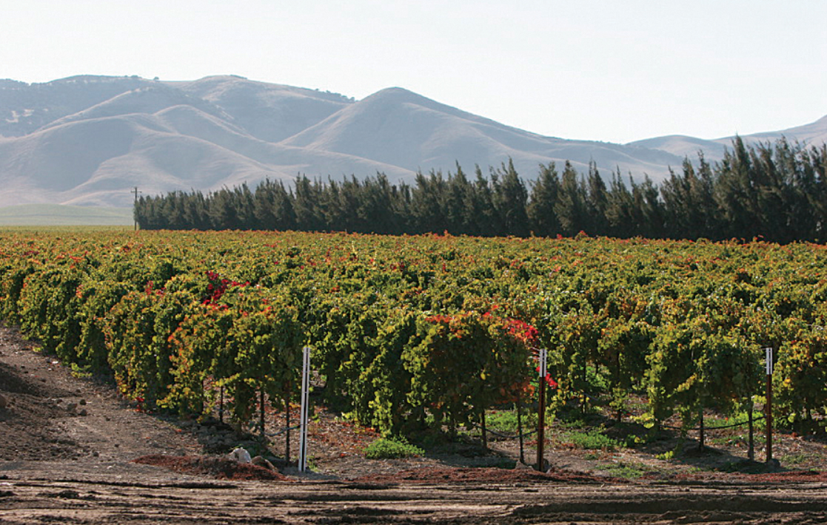
Agricultural-water use (AG) Package for gsflow
Hyper-resolution modeling of Regional water use by agriculture with integrated hydrology

Slide 2
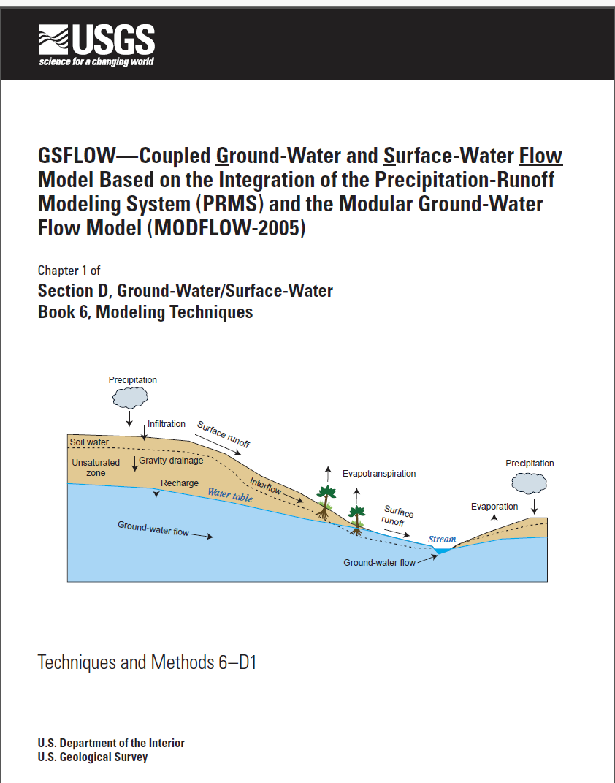
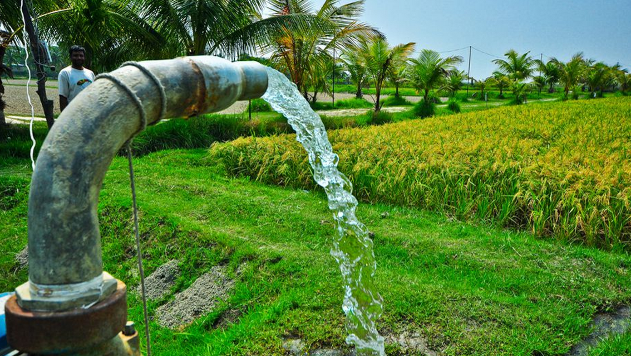
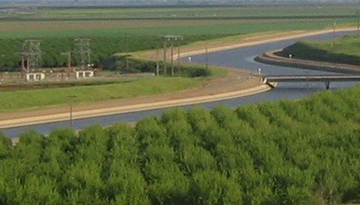
Agricultural-water use (AG) Package for gsflow
Developed using concept of Net Irrigation Water Requirement (NIWR)
How much water should be diverted/pumped to provide well-watered conditions?
How does water supply limit consumption?
+

Slide 3

Agricultural-water use—at the intersection of supply and demand
Demand estimated using land use, climate, and ET deficit
Hydrology model simulates water supply
Competition among different water sectors (ag., muni, res., indus.)
Water Supply
Energy Demand

Slide 4
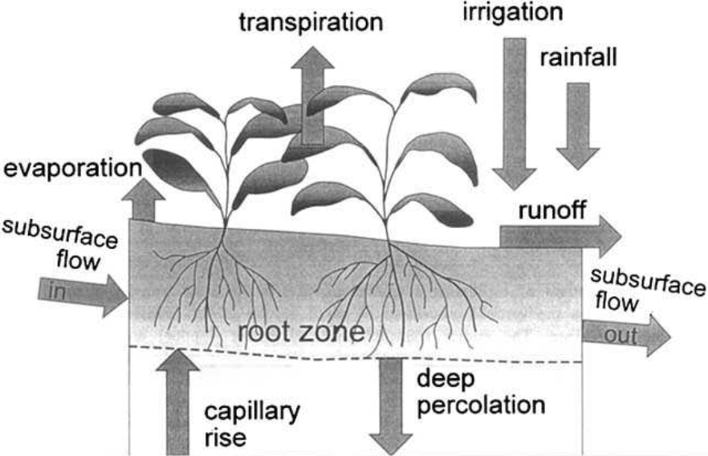
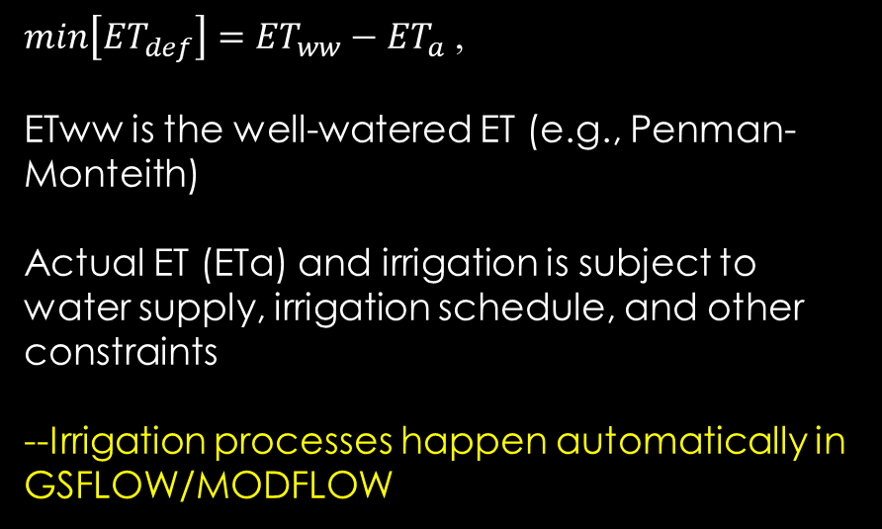
Energy and Soil-Water balance used to estimate NIWR
GSFLOW
Inverse problem: determine SW+GW irrigation amounts by minimizing the ET deficit:
${min\left[{ET}_{def}\right]=ET}_{ww}−{ET}_{a}$ ,
ETww is the well-watered ET (e.g., Penman-Monteith)
Actual ET (ETa) and irrigation is subject to water supply, irrigation schedule, and other constraints
--Irrigation processes happen automatically in GSFLOW/MODFLOW

Slide 5
Irrigation option 1 (simple)
ETww/ETa
Irrigation demands (NIWR) are specified as time series SW diversions or GW pumping rates
Water supply limits irrigation and GW can be used to automatically supplement SW
ET can be simulated in fields or efficiency factors can be specified to remove crop consumption from model
Return flows can be simulated

Slide 6



solution for NIWR-option 2
ETww/ETa
Actual ET (ETa) is a nonlinear function of NIWR, apply Newton method:
$${ET}_{a,i+1}= {ET}_{a,i}+\left[{∂ET}_{a,i}/∂{NIWR}_{i}\right]{∆NIWR}_{i+1}$$
${NIWR}_{i+1}= {NIWR}_{i}+\frac{{ET}_{a,i+1}−{ET}_{a,i}}{{∂ET}_{a,i}/∂{NIWR}_{i}}$
i=7
Irrigate farms
i=3
i=4
$∂ET/∂$Q
Energy/water budget
i=2
SW+GW
GSFLOW
Demand

Slide 7



solution for NIWR-option 3
Energy/water budget
Irrigation is “triggered” by field conditions:
$${{ET}_{a}}/{{ET}_{ww}}<{FCT}_{Trigger}$$
Calculate ${{ET}_{a}}/{{ET}_{ww}}$
Irrigation continues while:
Divert SW, pump GW
$$T_{irr}≤ T_{period}$$
Irrigation rate specified by user and can be supplemented by groundwater
Irrigate fields

Slide 8
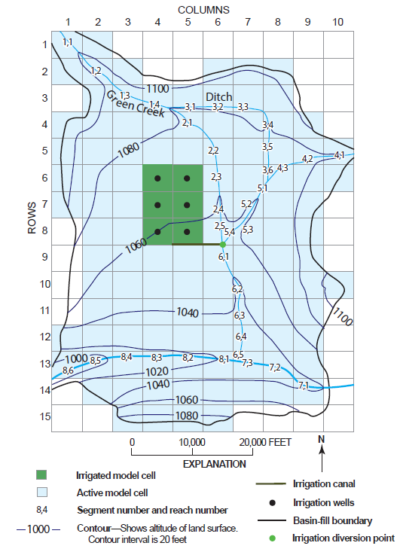
Example problem 1
MODFLOW-ONLY
Energy and water budget calculated by UZF Package
3,440 acres of irrigated fields

Slide 9
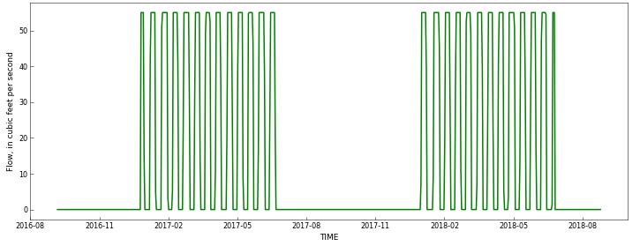
Imposed irrigation schedule (maximum SW diversions)
Irrigation is constrained to periods of non-zero flow shown by green line

Slide 10
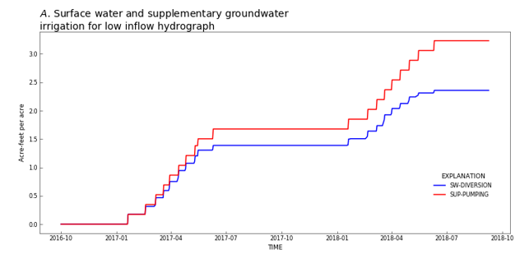
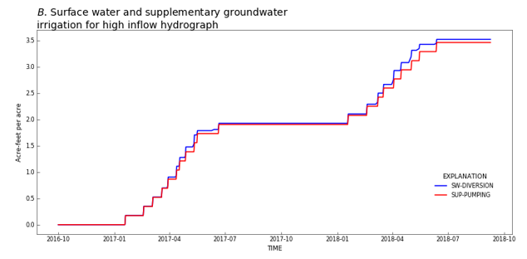
Conjunctive-USE of Surface water and groundwater
Dry climate
Moderate climate
GW Pumping
SW diversions
More supplementary groundwater pumping for dry climate

Slide 11
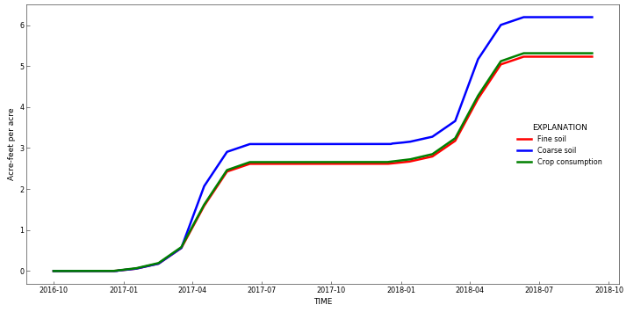
Impacts of field soil texture on NIWR (groundwater only)
Coarse soils require more irrigation due to rapid percolation below root zone

Slide 12
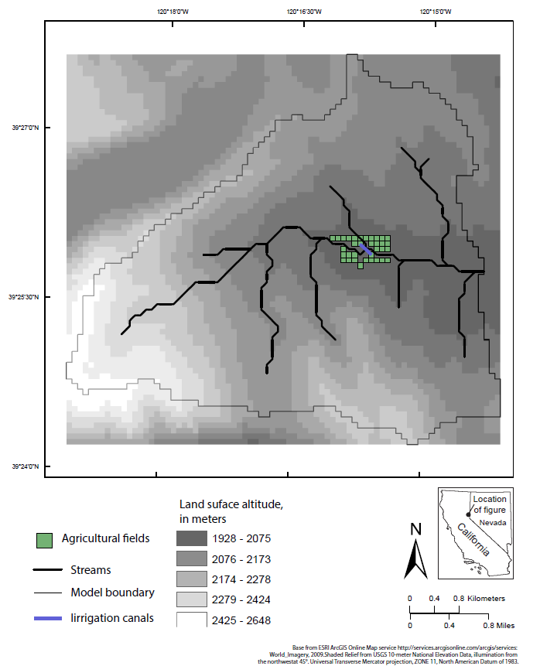
Example problem 2
GSFLOW
ENERGY AND SOIL-WATER BALANCE CALCULATED BY PRMS
27.5 hectares of irrigated fields

Slide 13
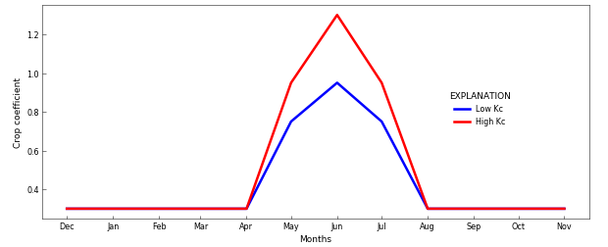
impacts of crop type (crop coefficient)

Slide 14
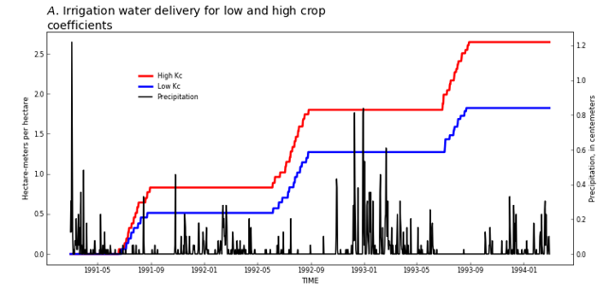
Irrigation amounts determined by minimizing ET deficit
Surface water and groundwater irrigation amounts for low and high crop coefficient (Kc) values
Low annual irrigation
High annual irrigation
Low precipitation
High precipitation

Slide 15
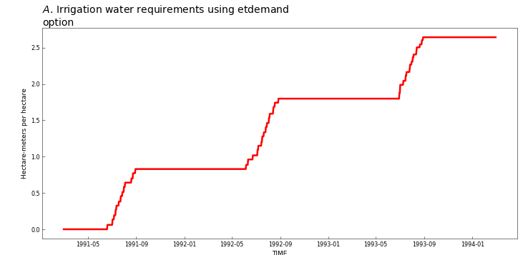
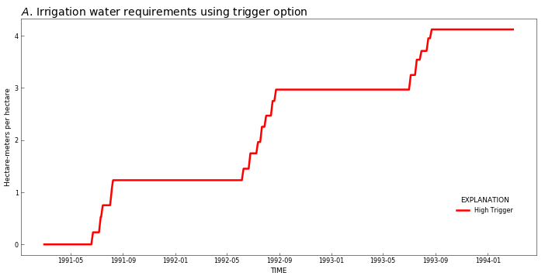
Comparison of niwr for 2 options (Trigger verses demand)
Average annual NIWR=0.9 meters
Average annual NIWR=1.4 meters

Slide 16
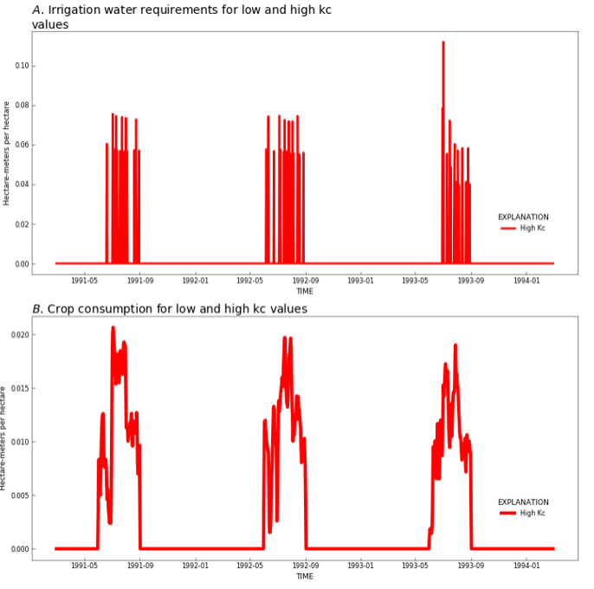
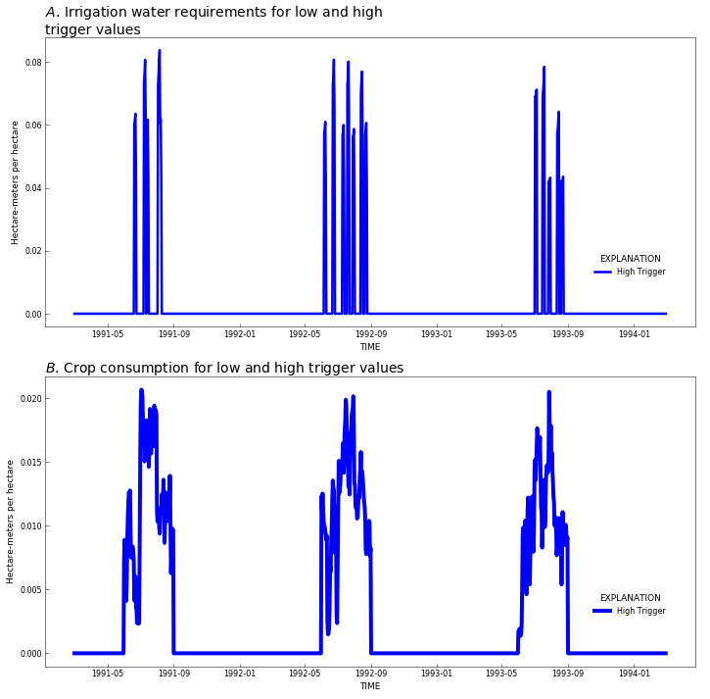
Differences in irrigation for options

Slide 17
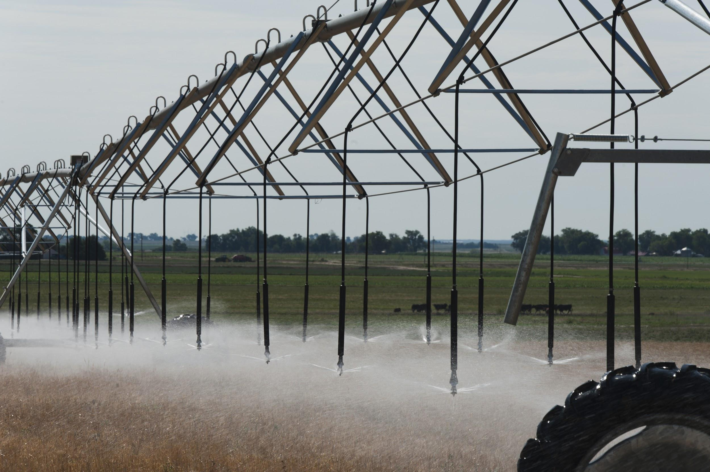
AG Package for gsflow
Automatically distributes water for irrigation using energy/water budget and mimics different types of grower behavior
Internal demand calculation for GSFLOW, considers evolving water supply conditions
Climate change impacts on agriculture, low flows, groundwater levels, and reservoirs available through GSFLOW

Slide 18
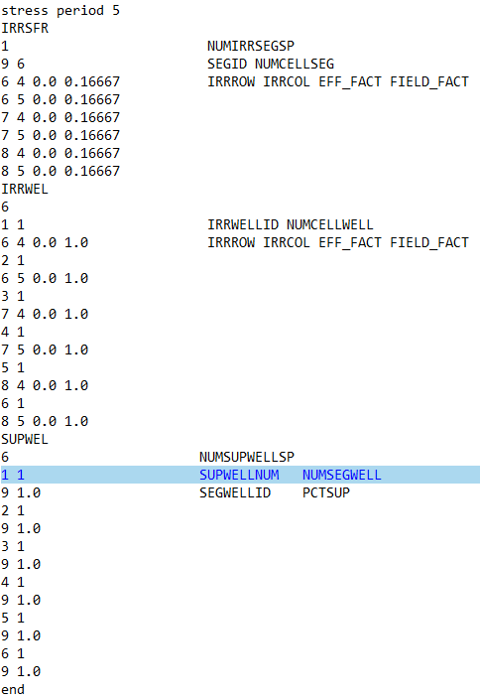
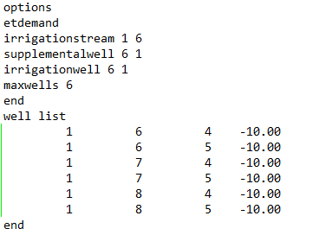
AG Package Input file structure (Key words)
Well list can use TABFILES to change max constraint on pumping

